Slide 1
Lesson 7 python programming
Natural language processing in Python using NLTK

Slide 2
Agenda
NLP

Slide 3
Natural Language Processing
Computer aided text analysis of human language.
The goal is to enable machines to understand human language and extract meaning from text.
It is a field of study which falls under the category of machine learning and more specifically computational linguistics.
The “Natural Language Toolkit” is a python module that provides a variety of functionality that will aide us in processing text.

Slide 4
Natural Language applications
Search engines
Site recommendations
Spam filtering
Knowledge bases and expert systems
Automated customer support systems
Banking fraud detection
Consumer behavior analysis

Slide 5
What is NLTK? most widely used
To introduce Natural Language Toolkit(NLTK),
an open source library which simplifies the implementation of Natural Language Processing(NLP) in Python.

Slide 6
Downloads and Installation
Installation instructions at: https://pypi.python.org/pypi/nltk
Also download corpora, packages and the data used for examples in the book.
From Python:
>>>import nltk
>>>nltk.download()
Opens the NLTK downloader, you can choose what to download.

Slide 7
HOW: Session Layout
This session is divided into 2 parts:
Natural Language Processing (NLP) – The concept
Natural Language Toolkit (NLTK) – The tool for NLP implementation in Python
Python
NLP
NLTK

Slide 8
NLTK modules and functionality
NLTK modules | Functionality
nltk.corpus | Corpus
Nltk.tokenize,nltk.stem | Tokenizers, Stemers
Nltk.collacations | T-test,chi-squared, mutual-info
Nltk.tag | N-gram
Nltk.cluster, nltk.classify | Decision tree, naïve bayes, K means
Nltk.chunk | Regex, n-gram, named-entity
Nltk.parsing | parsing
Nltk.metrics | Evaluation metrics
Nltk.probability | Probability and estimation
Nltk.app, nltk.chat | Applications

Slide 9
Text corpora
Corpus
Large collection of text
Raw or categorized
Concentrate on a topic or open domain
Examples
Brown - first, largest corpus, categorized by genre
Webtext - reviews, forums, etc.
Reuters - news corpus
udhr - multilingual

Slide 10
WordNet
Structured, semantically oriented English dictionary
Synonyms, antonyms, hyponims, hypernims, depth of a synset, trees, etc.

Slide 11
WordNet: Example
import nltk
from nltk.corpus import wordnet as wn
synsets = wn.synsets('phone')
print [str(syns.definition) for syns in synsets]
'electronic equipment that converts sound into electrical signals that can be transmitted over distances and then converts received signals back into sounds‘
'(phonetics) an individual sound unit of speech without concern as to whether or not it is a phoneme of some language‘
'electro-acoustic transducer for converting electric signals into sounds; it is held over or inserted into the ear‘
'get or try to get into communication (with someone) by telephone'

Slide 12
Tokenization
Tokenization is the process of breaking a stream of text up into words, phrases, symbols, or other meaningful elements called tokens.

Slide 13
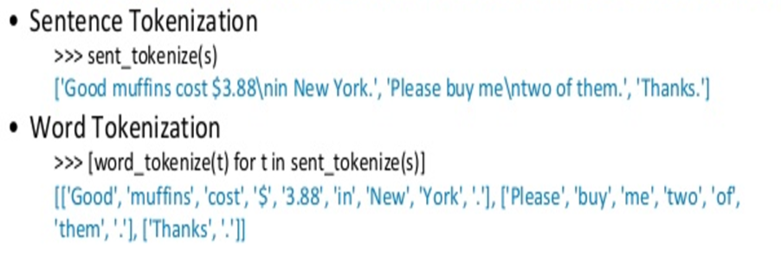
Tokenization: Example

Slide 14
Stemming
Stemming is the process for reducing injected words to their stem, base root form

Slide 15
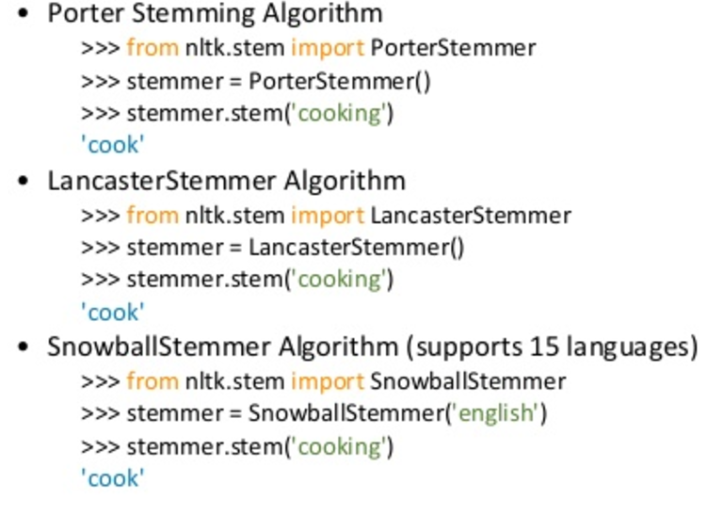
Stemming : Example

Slide 16
Normalizing Text (cont)
Lemmatization process involves first determining the part of speech of a word and applying different normalization rules for each part of speech.
remove upper case and capital letter

Slide 17
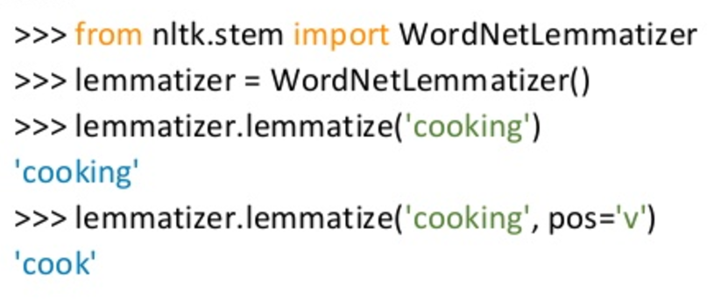
Normalizing Text (cont.): Example

Slide 18
Comparison: stemming, lemmatization
>>>stemmer.stem(‘better’)
‘null’
>>>Lemmatizer.lemmatize(‘better’)
‘good’
>>>stemmer.stem(‘walking’)
‘walk’
>>>Lemmatizer.lemmatize(‘walking’)
‘walk’
>>>stemmer.stem(‘meeting’) in our last meeting
‘meet’
>>>Lemmatizer.lemmatize(‘meeting’)
‘meeting’

Slide 19
Part of speech tagging
Part of speech tagging is the process of marking up a word in a text(corpus) as corresponding to a particular part of speech.

Slide 20
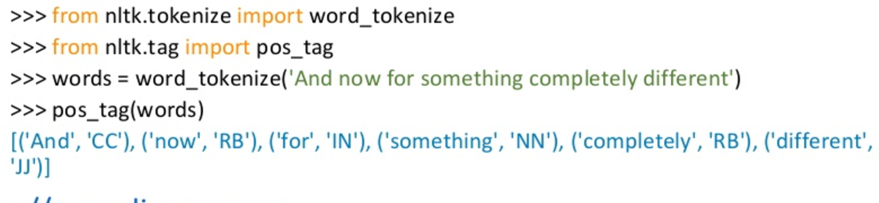
Part of speech tagging: Example

Slide 21
Penn Bank Part-of-Speech Tags
CC | Coordinating conjunction
CD | Cardinal number
DT | Determiner
EX | Existential "there"
FW | Foreign word
IN | Prepostion or subordination conjunction
JJ | Adjective
JJR | Adjective- comparative
JJS | Adjective- superlative
LS | List item marker
MD | Modal
NN | Noun- singular or mass
NNS | Noun- plural
NP | Proper noun- singular
NPS | Proper noun- plural

Slide 22
Unigram and N-gram tagging
Unigram tagging - nltk.UnigramTagger()
assign the tag that is most likely for that particular token
train it specifying tagged sentence data as a parameter when we initialize the tagger
separate training and testing data
N-gram tagging
context is the current word together with the part-of-speech tags of the n-1 preceding tokens
evaluate performance
contexts that were not present in the training data
- accuracy vs. coverage
combine taggers

Slide 23
Trigram: Example
The sentence "the quick red fox jumps over the lazy brown dog" has the following word level trigrams:
the quick red
quick red fox
red fox jumps
fox jumps over
jumps over the
over the lazy
the lazy brown
lazy brown dog

Slide 24
Named entity recognition
Named entity recognition is the subtask of information extraction that seeks to locate and classify elements in text into pre-defined categories such as the names of the person, organizations, locations, expressions of times, quantities, etc.

Slide 25
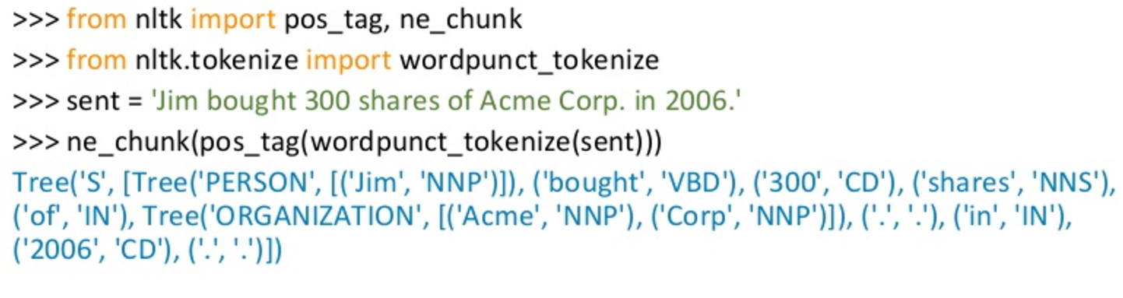
Named entity recognition: example

Slide 26
Constructing chunkers:
using rule-based systems, such as the RegexParser class provided by NLTK
using machine learning techniques, such as the ConsecutiveNPChunker
POS tags are very important in this context.

Slide 27
Relation extraction
using rule-based systems which look for specific patterns in the text that connect entities and the intervening words
using machine-learning systems which attempt to learn patterns automatically from a training corpus

Slide 28
Stop!! You are here to think about
Determining the topic of an article or a book
Deciding if an email is spam or not
Determining who wrote a text
Determining the meaning of a word in a particular context
Creating a new poem out of a text

Slide 29
Usecase: spelling corrector
In the first step, It gets all the words from the corpus
Then choose top ten words

Slide 30
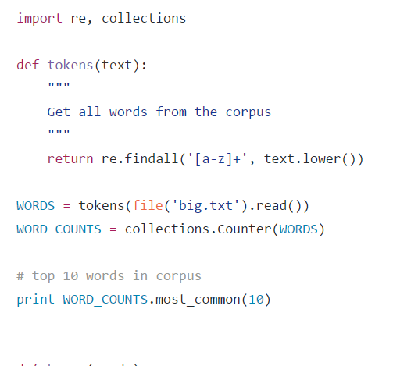
Get top ten words

Slide 31
Use case: explanations
Then return all the words that are zero or one edits away from our input

Slide 32
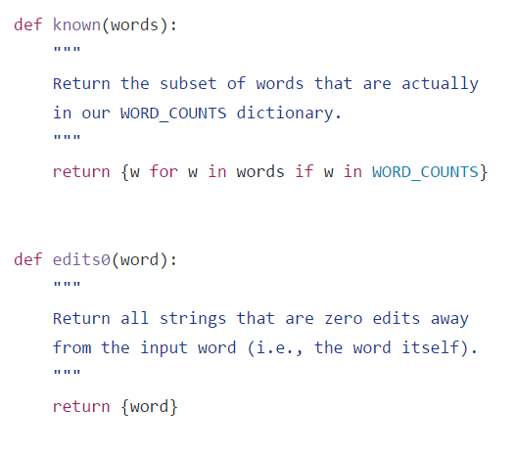
Spelling corrector:step3

Slide 33
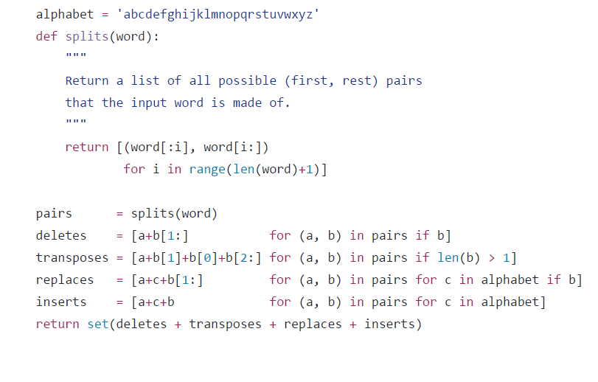
a list of possible pairs that input word is made of

Slide 34
Spelling corrector: step 5
Get the best correct spelling for the input word
The priority is for edit distance 0 then 1 then 2

Slide 35
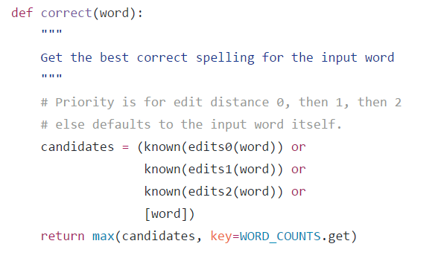
Spelling corrector: step 5

Slide 36
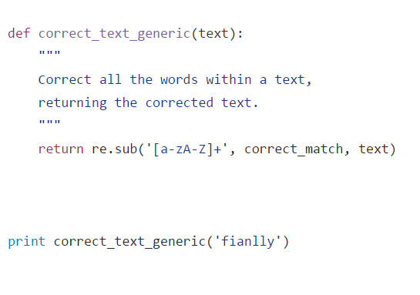
Return the corrected text

Slide 37
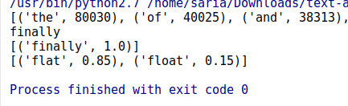
Result : flat → float

Slide 38
References
https://github.com/wade12/WikiScraper/blob/master/
http://www.w3resource.com/python-exercises/
https://www.learnpython.org/

Slide 39
Thank you

